Slide 1
Retail Banking
Presented by :-
Rushin nazeer
Riya thevar
sagar singh

Slide 2
WHAT IS RETAIL BANKING?
Retail banking, also known as consumer banking, is the typical mass-market banking in which individual customers use local branches of larger commercial banks. Services offered include savings and checking accounts, mortgages, personal loans, debit/credit cards and certificates of deposit

Slide 3
Problem Statement
Design a data warehouse for a retail banking system to answer the key business questions and provide optimal solutions for pertinent issues.
We will be using 11 dimensions in the data model namely, Bank, Branches, Employees, Customers, Accounts, Contacts, Cards, Loans, Transactions, Locations and Time.

Slide 4
Dimension Table
A Dimension Table is a table in a star schema of a data warehouse. Data warehouses are built using dimensional data models which consist of fact and dimension tables. Dimension tables are used to describe dimensions; they contain dimension keys, values and attributes.
For example, the time dimension would contain every hour, day, week, month, quarter and year that has occurred since you started your business operations.

Slide 5
Bank Table
The bank table have the following fields namely
Bank ID(PRIMARY KEY)
Bank Name

Slide 6
Branches Table
The Branches table have the following fields namely
Branch_ID(PRIMARY KEY)
Branch Name
Bank ID
Location

Slide 7
Employees Table
The Employees Table have the following fields namely
EMPID(PRIMARY KEY)
EMPNAME
DEPT(Department)
PHONE
ADDRESS
SALARY
HIRE_DATE
F_BRANCHID(FOREIGN KEY FROM BRANCH TABLE)

Slide 8
Customer Table
The Customer Table have the following fields namely
CustID(PRIMARY KEY)
Fname
Lname
Account Number
Gender
Age
Ctype
CardNo

Slide 9
Location Table
The location Table have the following fields namely
Location_id(PRIMARY KEY)
Location Name
City
State
Country
Pin

Slide 10
Cards Table
The Cards Table have the following fields namely
Card Number(PRIMARY KEY)
Card Type(Debit or Credit)
Tier (Silver, gold or platinum)
Providers(Visa , Mastercard)
Issue Date
Expiry date

Slide 11
Transaction Table
The Transaction Table have the following fields namely
Transaction_ID(PRIMARY KEY)
Transaction Type
Transaction Descreption
Transaction Date

Slide 12
Contacts Table
The Contacts Table have the following fields namely
CID(Contacts ID) (PRIMARY KEY)
Phone Number
Address
Ctype(Contacts categorized as Senior Citizen, Student,Female)

Slide 13
Loans Table
The Loans Table have the following fields namely
LoanID(PRIMARY KEY)
Loan Type (Pesonal, Home,Education)
INITAMT
INITRATE
STATUS
START DATE
END DATE

Slide 14
Accounts Table
The Accounts Table have the following fields namely
ACCNO(Account Number) (PRIMARY KEY)
ACCTYPE (Types of Account such as Savings, Current)
OPENDATE
STATUS (Active or Deactivated or on HOLD)
END DATE

Slide 15
Time Dimension
The Time Dimension have the following fields namely
TimeID(PRIMARY KEY)
DateofYear
MONTH
QUARTER
Year

Slide 16
Facts Table
A Fact Table is a central table in a star schema of a data-warehouse. A fact table stores quantitative information for analysis and is often de-normalized. A fact table works with dimension tables and it holds the data to be analyzed and a dimension table stores data about the ways in which the data can be analyzed.

Slide 17
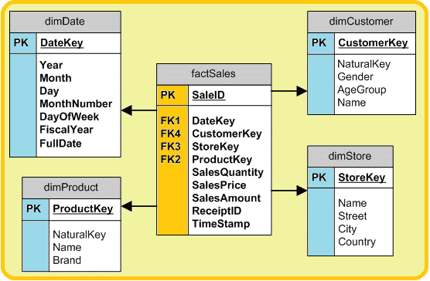
Facts Table (Contd..)

Slide 18
Facts Table
The facts table inherits the following primary keys from the dimension tables.
Branches
Customer
Locations
Cards
Transactions
Contacts
Loans
Accounts
Time Table

Slide 19
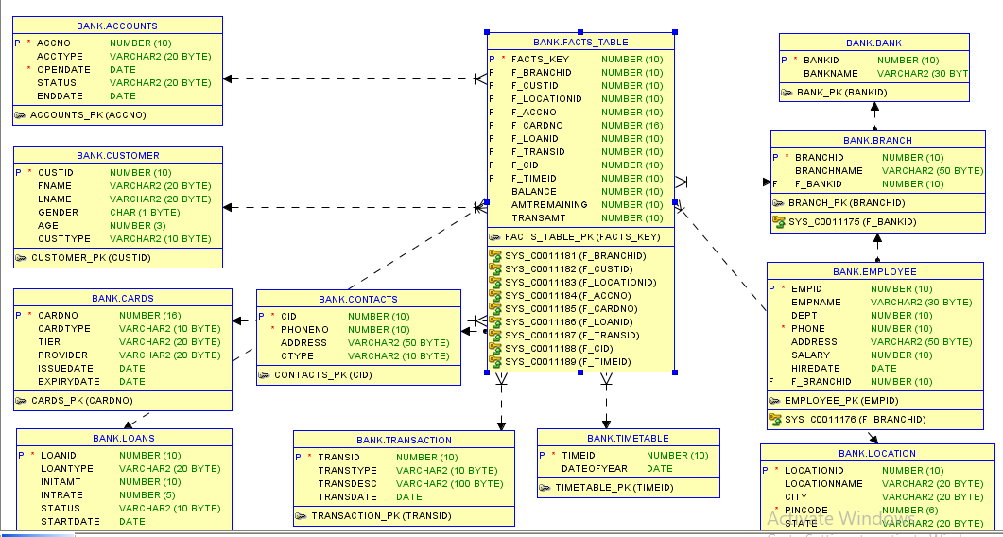
Retail Banking Schema

Slide 20
Challenges faced in Data Warehousing
As more and more information gets added to a data warehouse, management systems have to dig deeper to find and analyze it.
There is a variety of warehouse types available on the market today, which can make choosing one difficult. Your two basic options are pre-assembled and customized warehouses

Slide 21
Thank You

